Slide 1




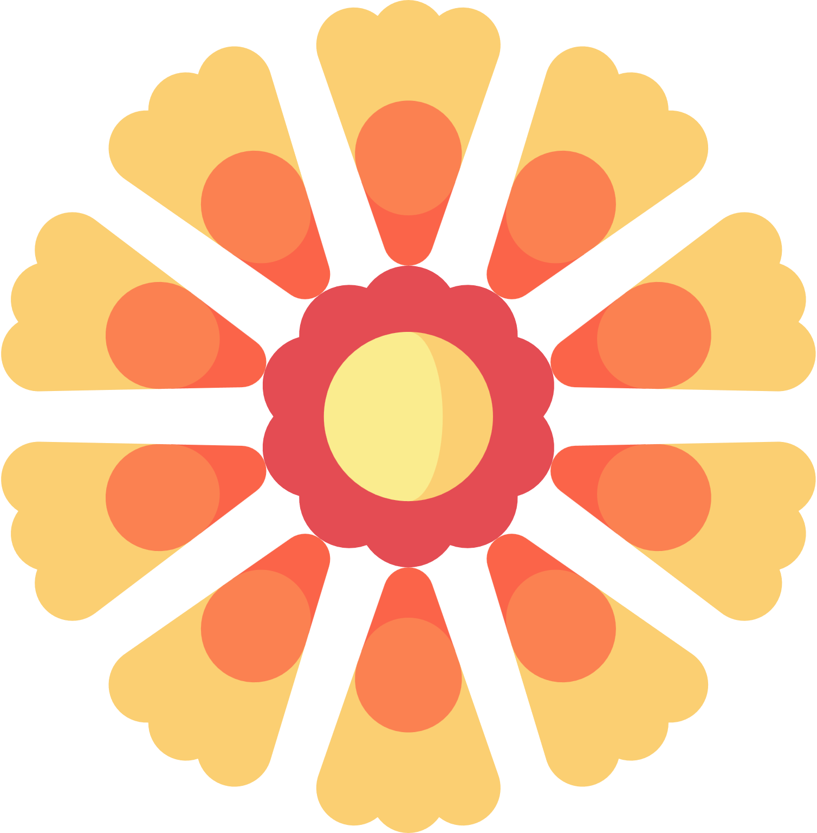
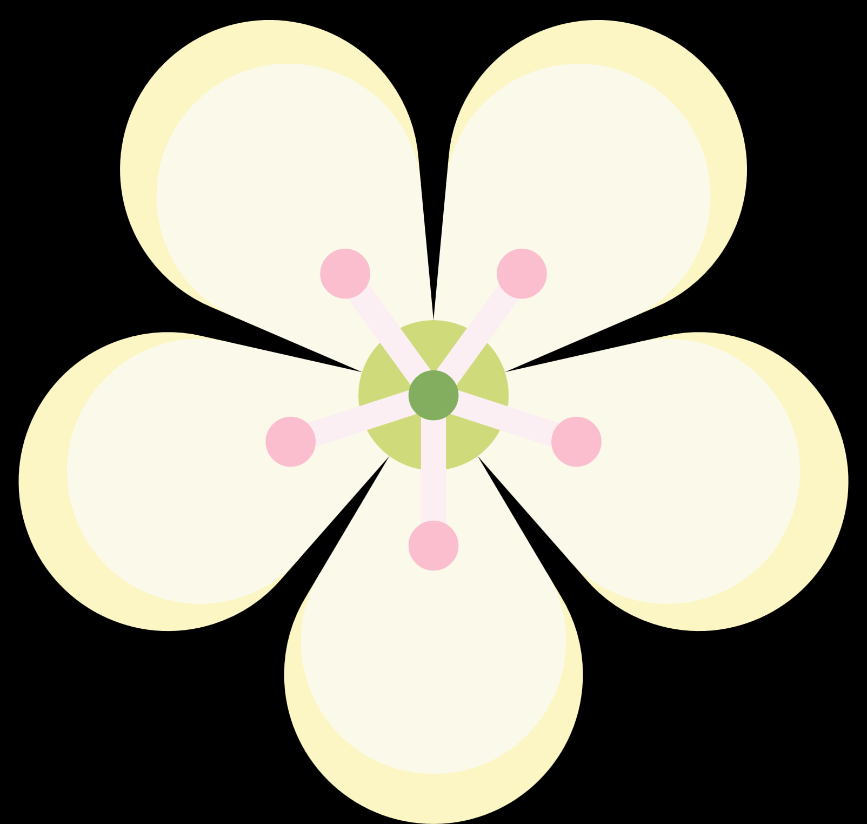
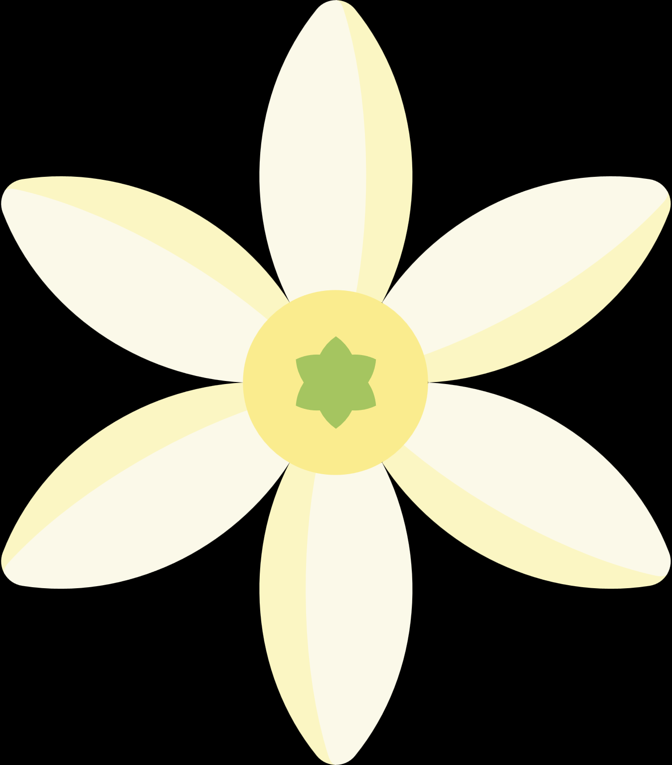


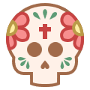
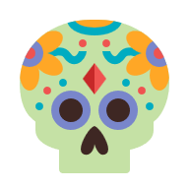
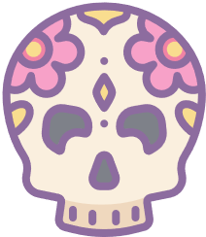

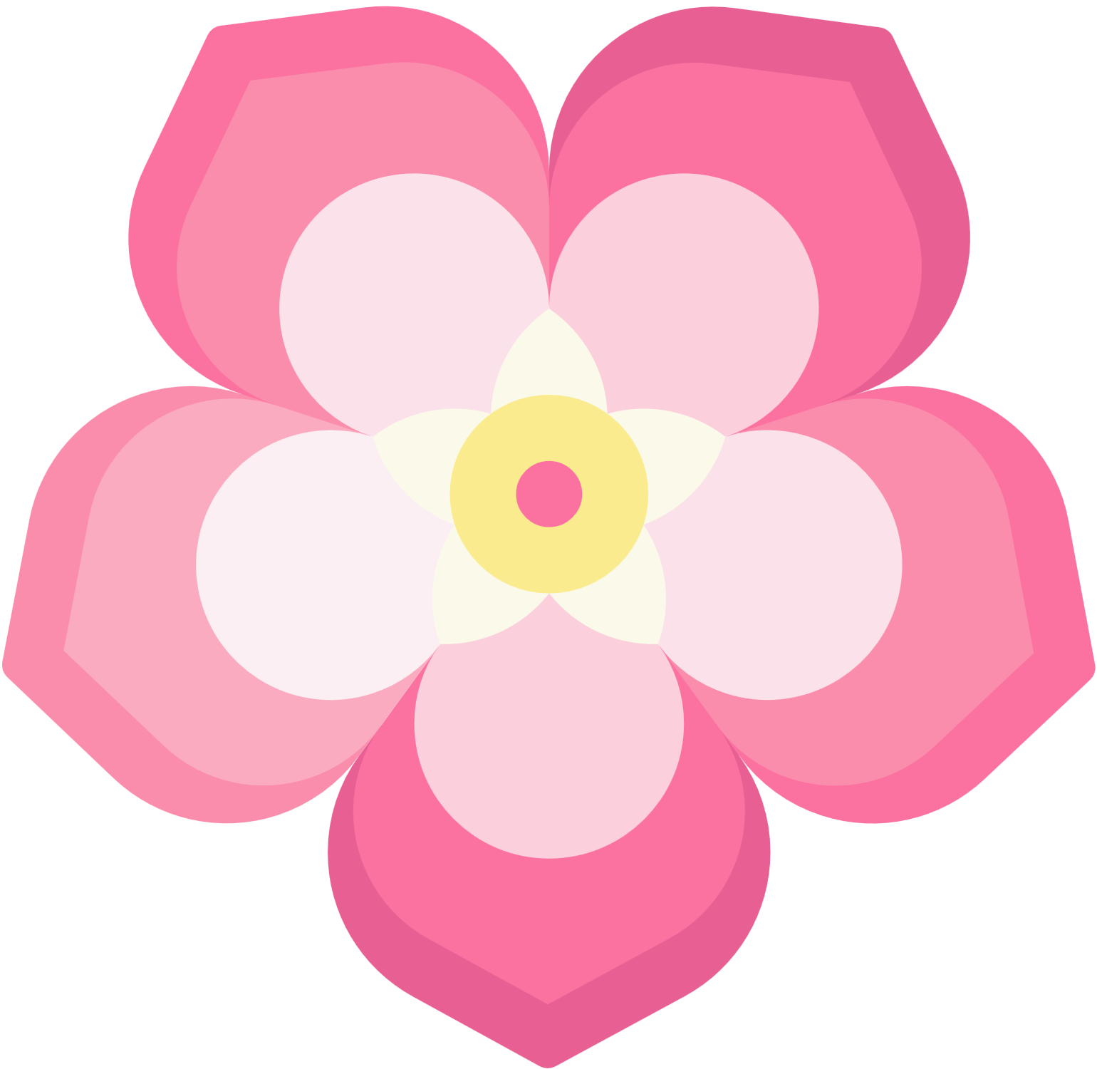

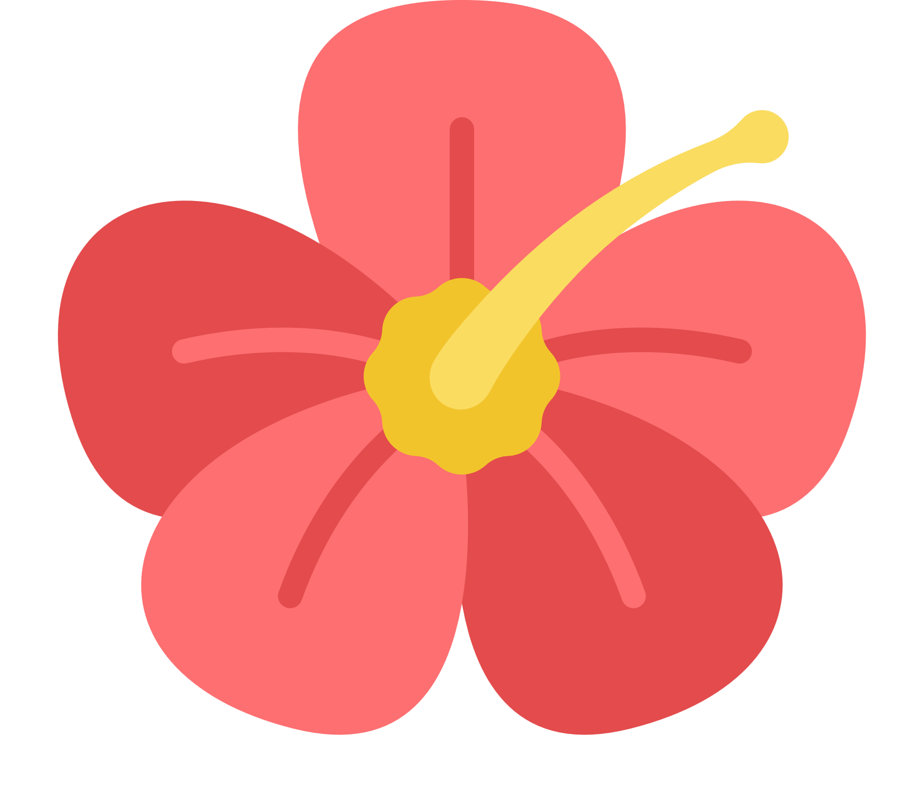

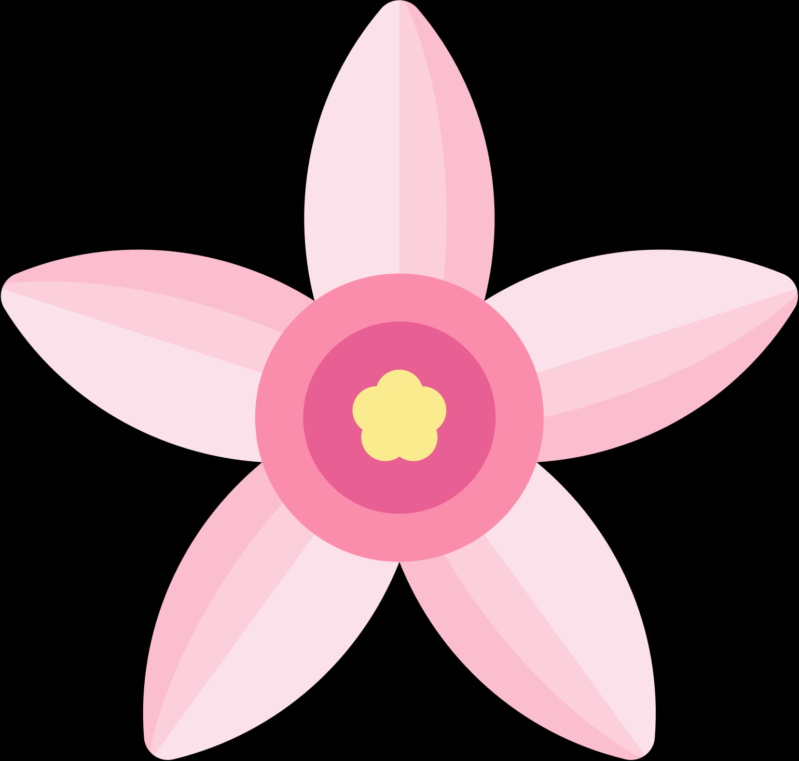
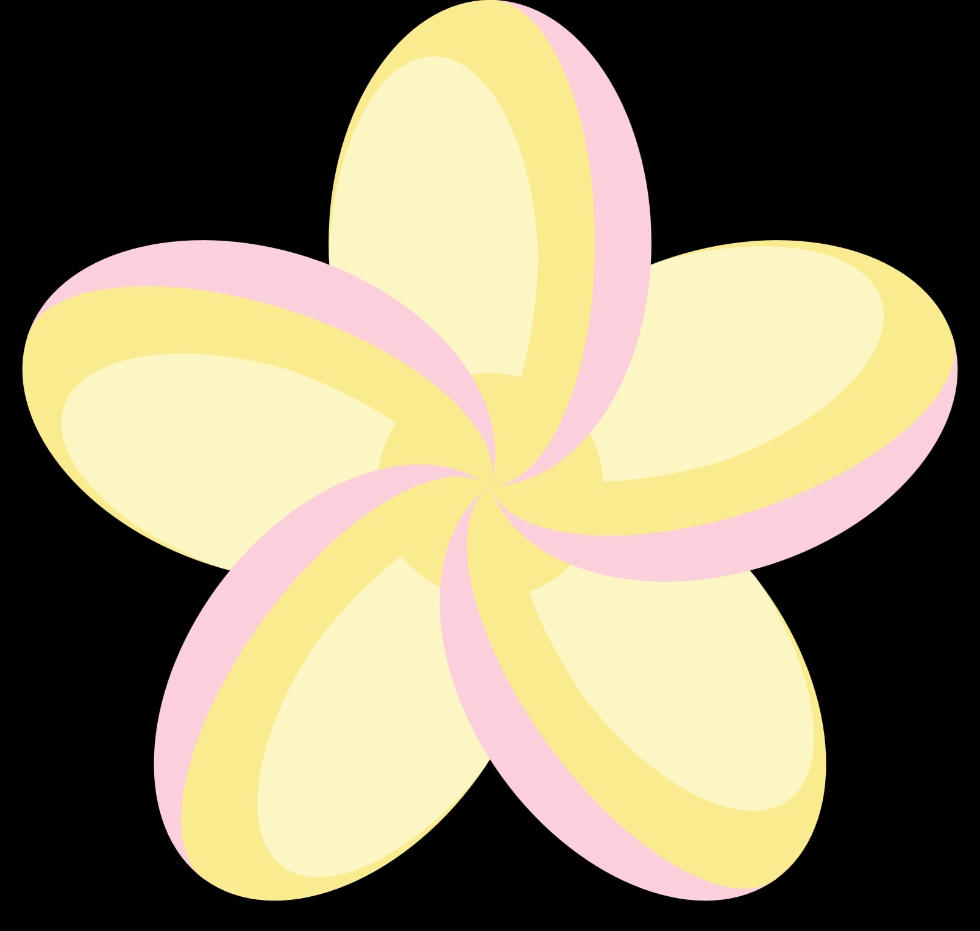
Happy
Day Of The
Dead
When someone you love becomes a
memory, the memory becomes a
treasure.

Slide 2
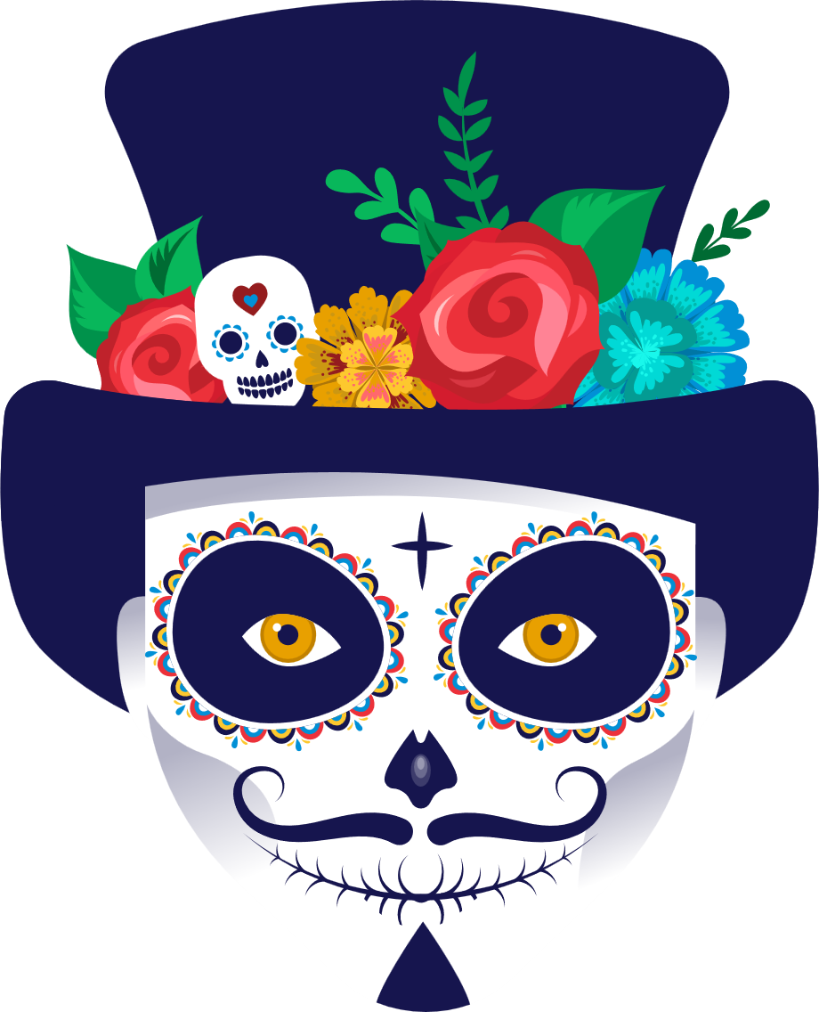
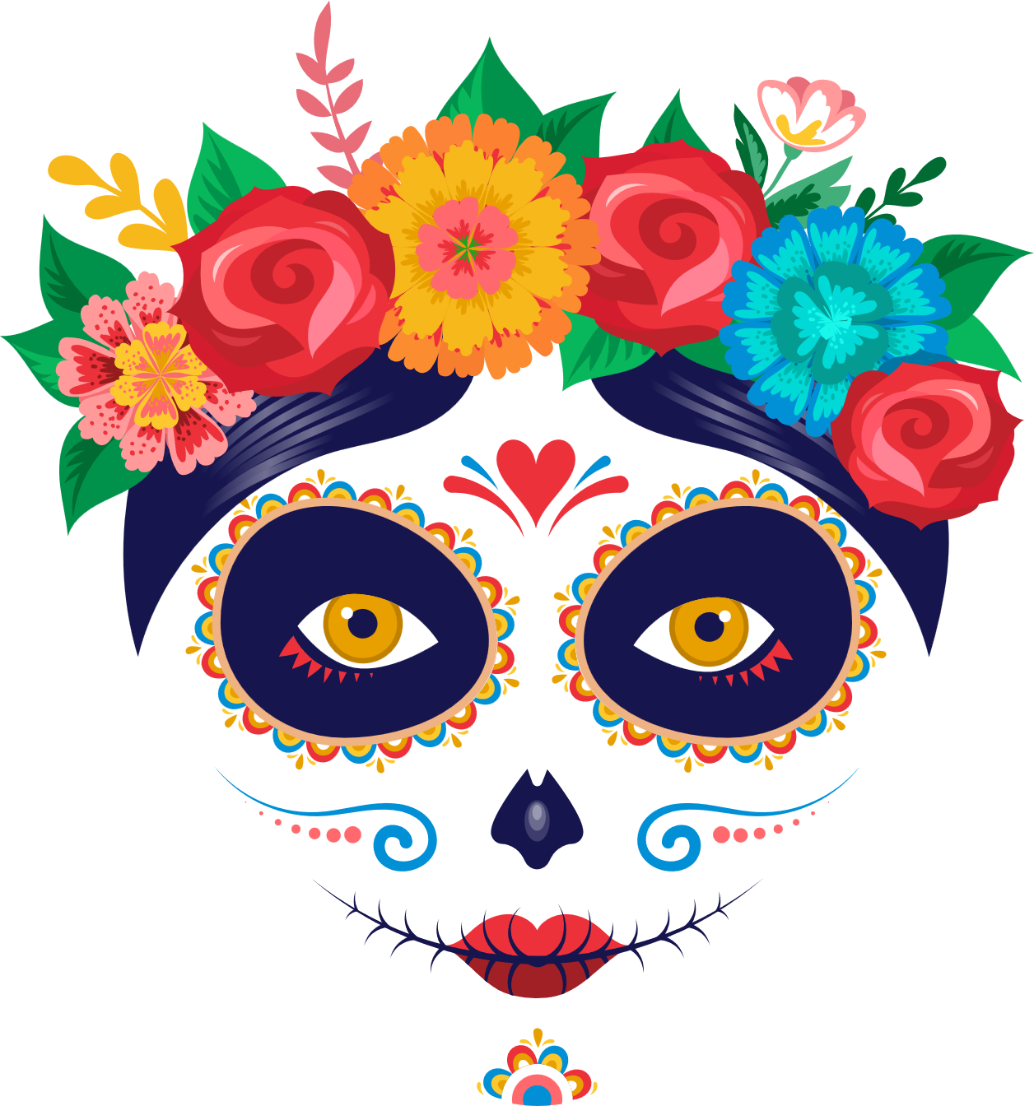

dia de los
MUERTOS

Slide 3

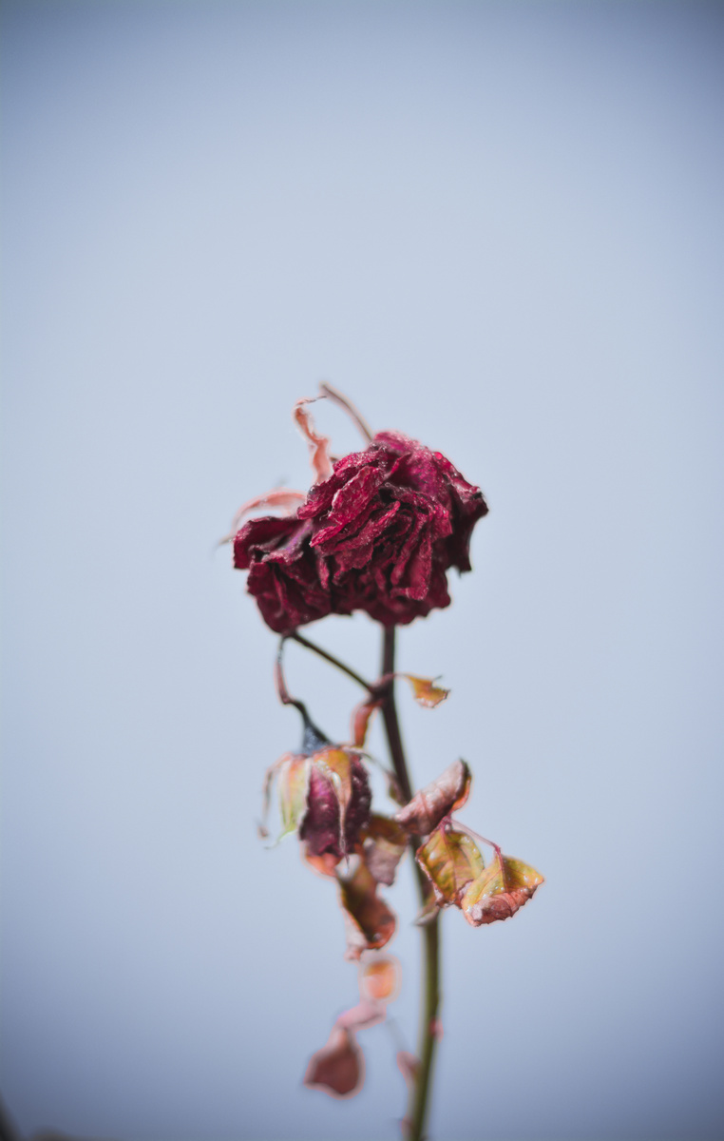
5 facts about Dia de los Muertos (Day of the Dead)

Slide 4
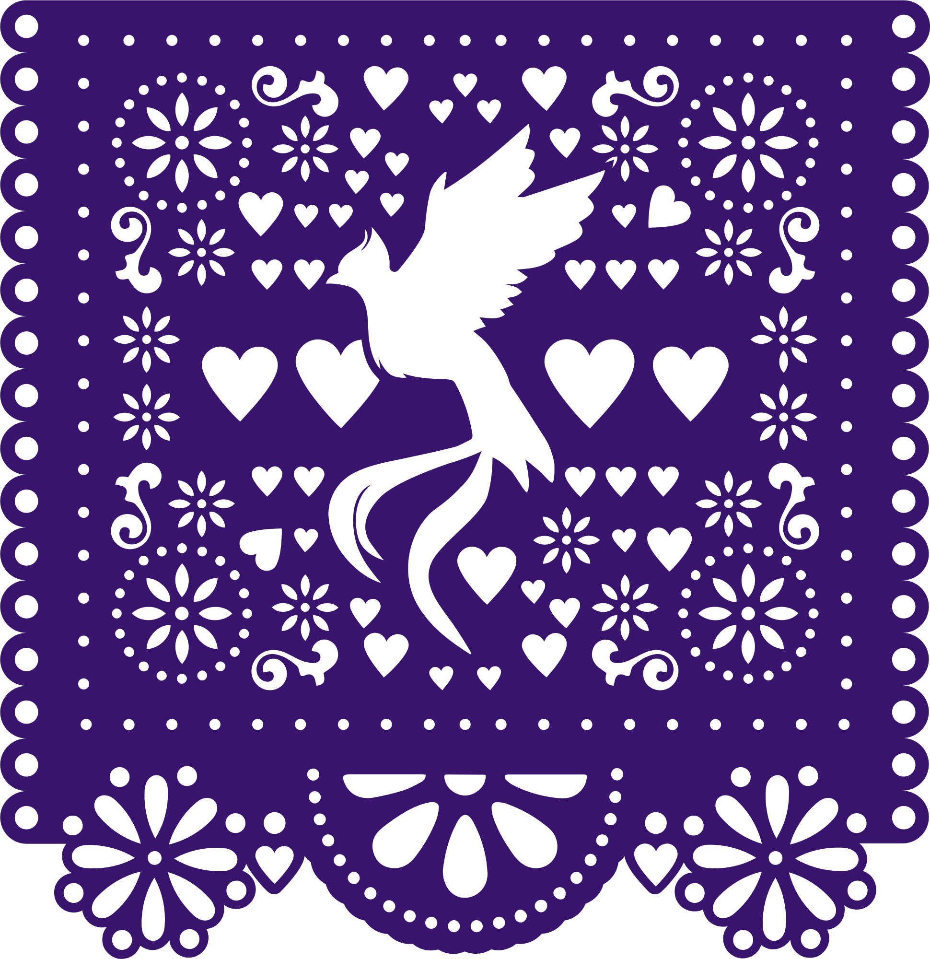
#1.
It's celebrated on Nov. 1

Slide 5

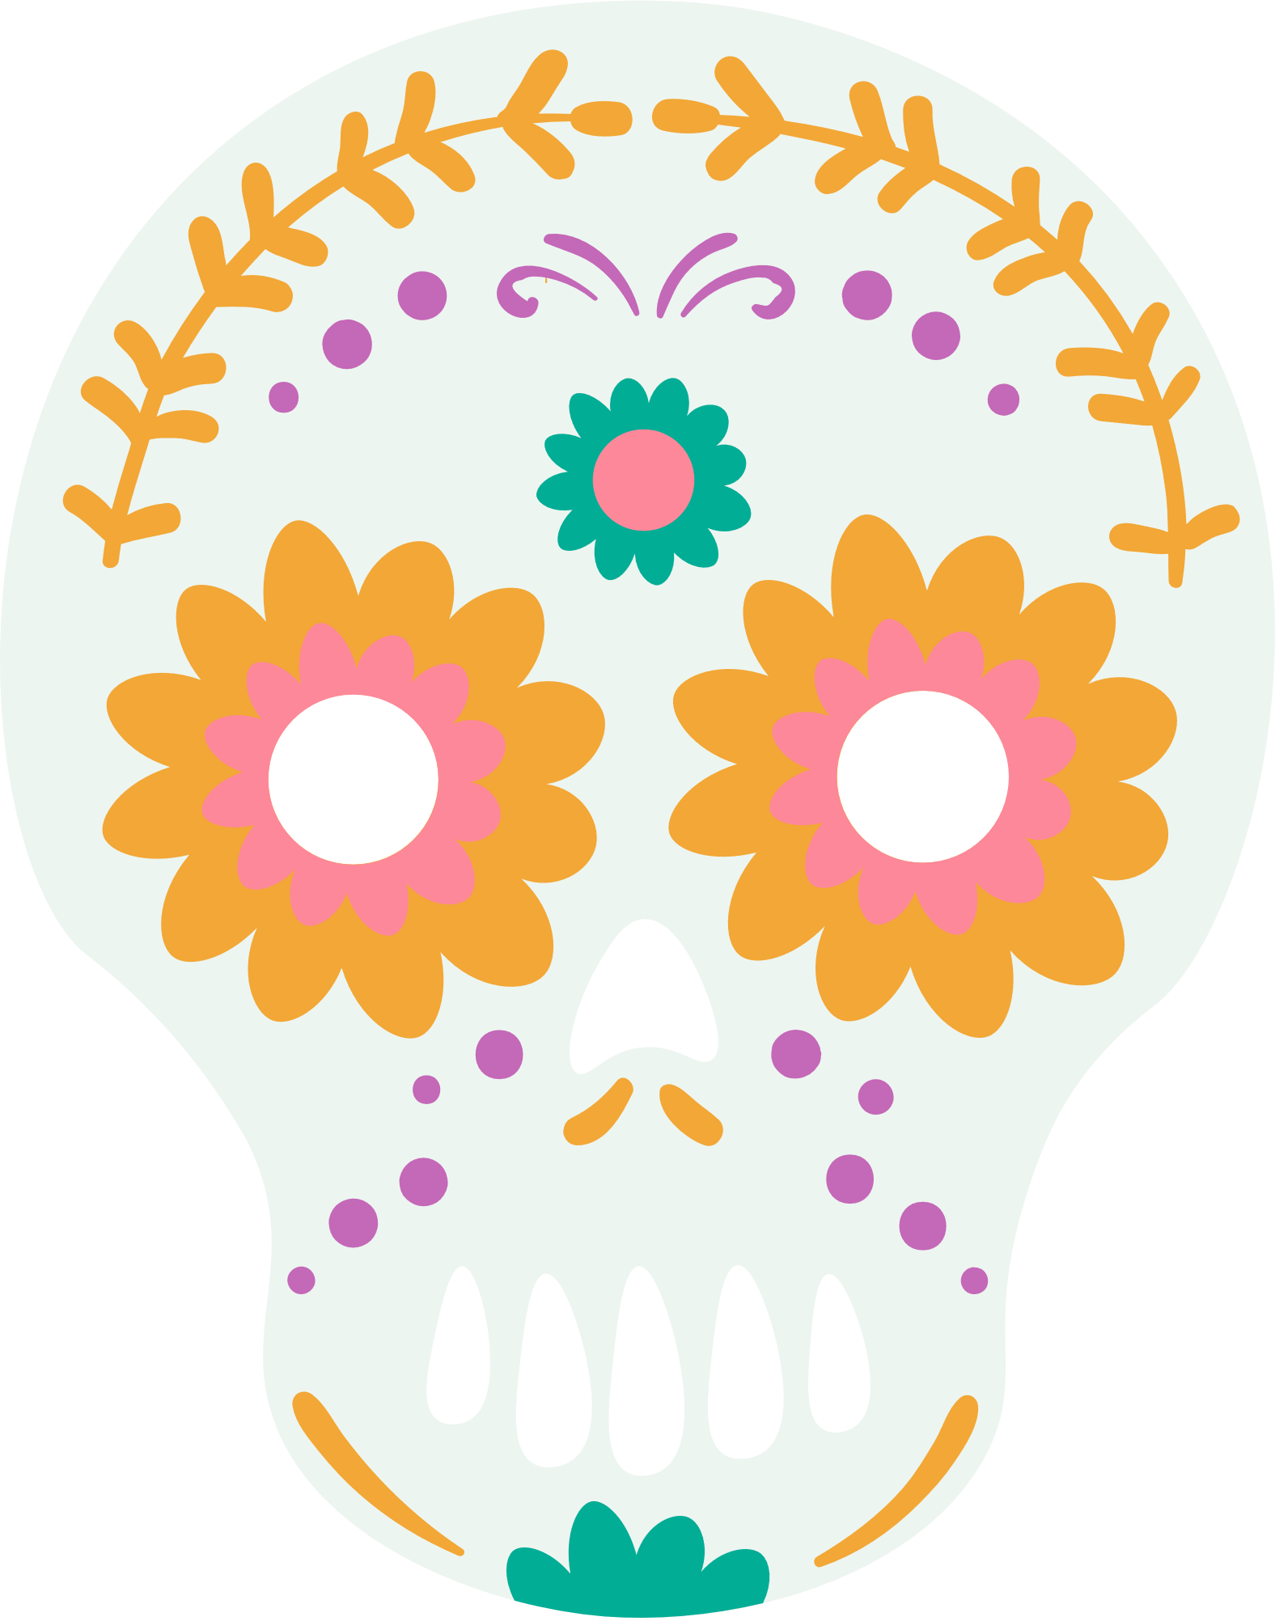

#2
IT ORGINATED IN MEXICO AND CENTRAL AMERICA

Slide 6
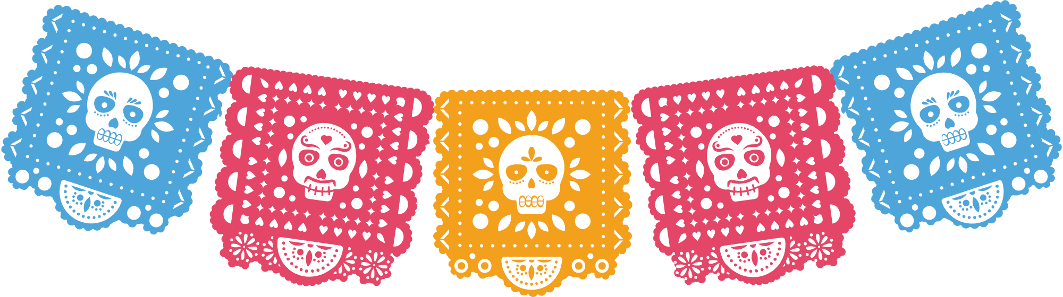
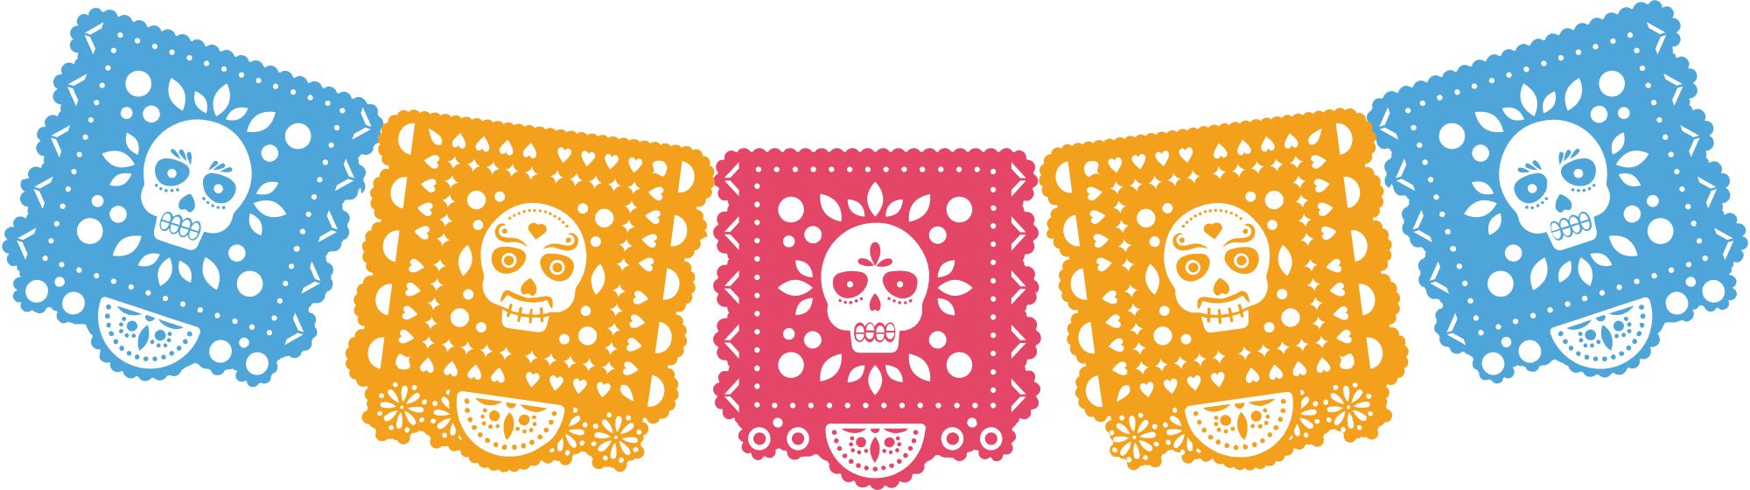
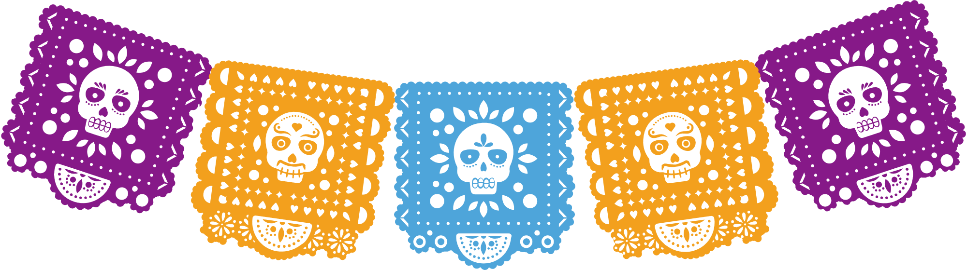
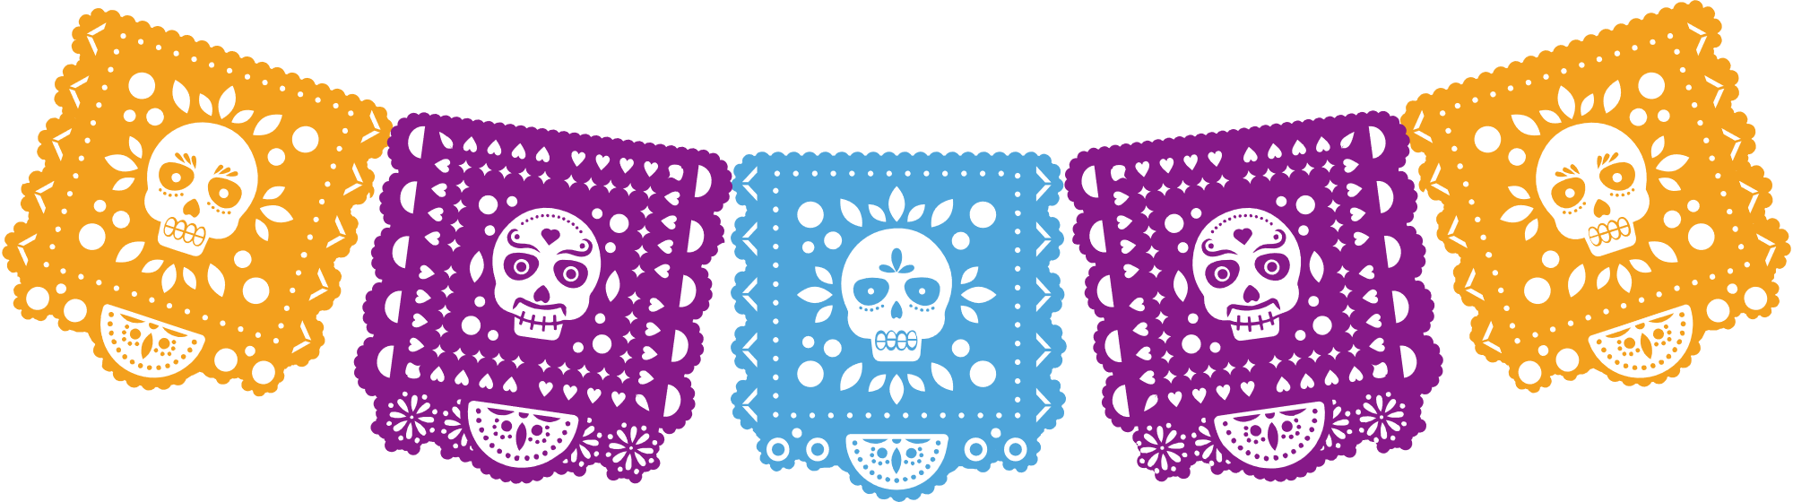


#3
It's a celebration of life,
not death.

Slide 7
#4
An ofrenda is a home altar with a collection of objects of your beloved.

Slide 8
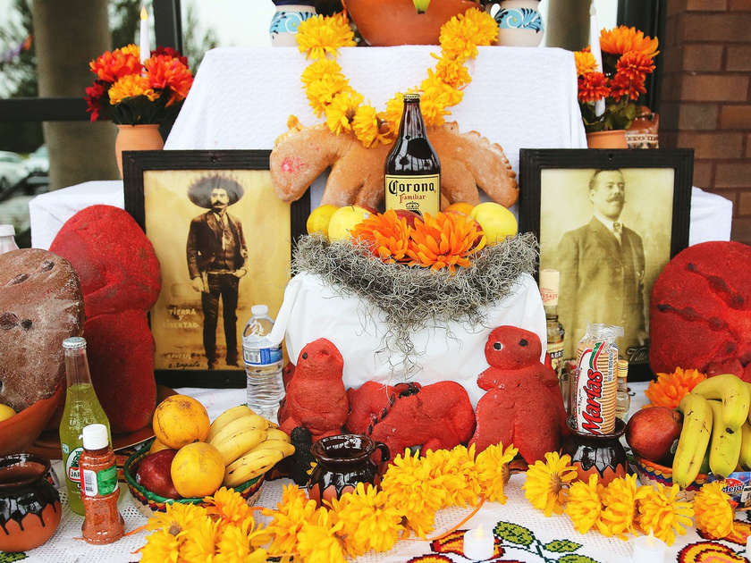
A sample altar

Slide 9
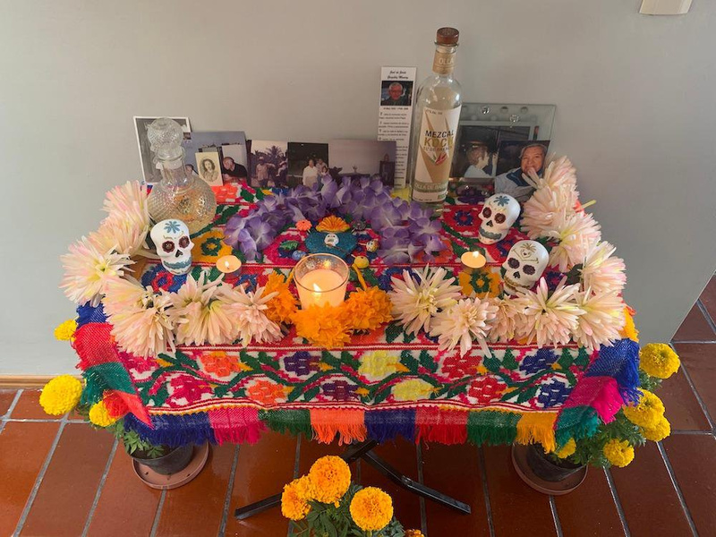
Another altar

Slide 10
#5
Flowers, butterflies and skulls are typically used as symbols

Slide 11


Slide 12
information from:
google.com search
What are 5 facts about Day of the Dead
all photos license free Canva
created by E.Doonan

