Slide 1
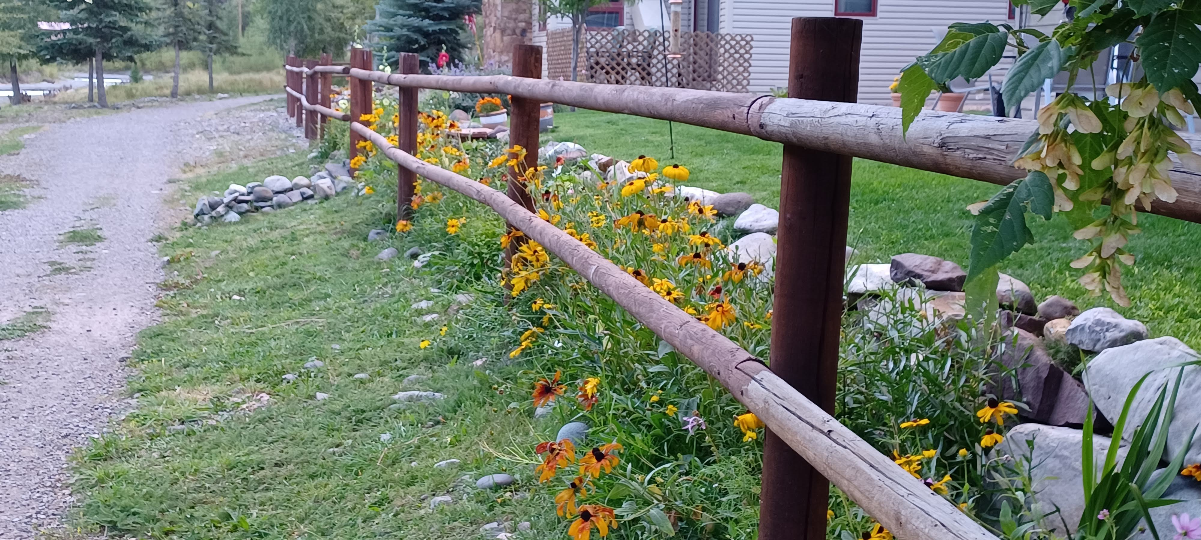
Being Well Mondays
Created by E. Doonan

Slide 2
Let’s Talk About Social Goals
What does that mean?
Does anyone have a social goal that they are working on?

Slide 3
Here are a few goals:
Eye contact
Personal space
Conversation
Do not fidget
Handshake
Listen
Pay attention
Repeat what was said
Ask a question
No distractions

Slide 4
Can there be more?

Slide 5
Let’s just go over some…
Eye contact
Why is this important?

Slide 6
Personal Space
What is the rule?
Important or not?

Slide 7
Conversation
What topics?
What about swear words?

Slide 8
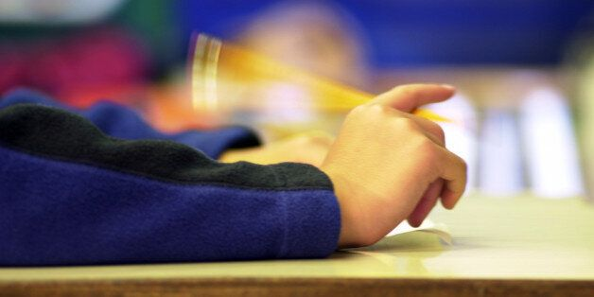
Fidget
Can I fidget?

Slide 9
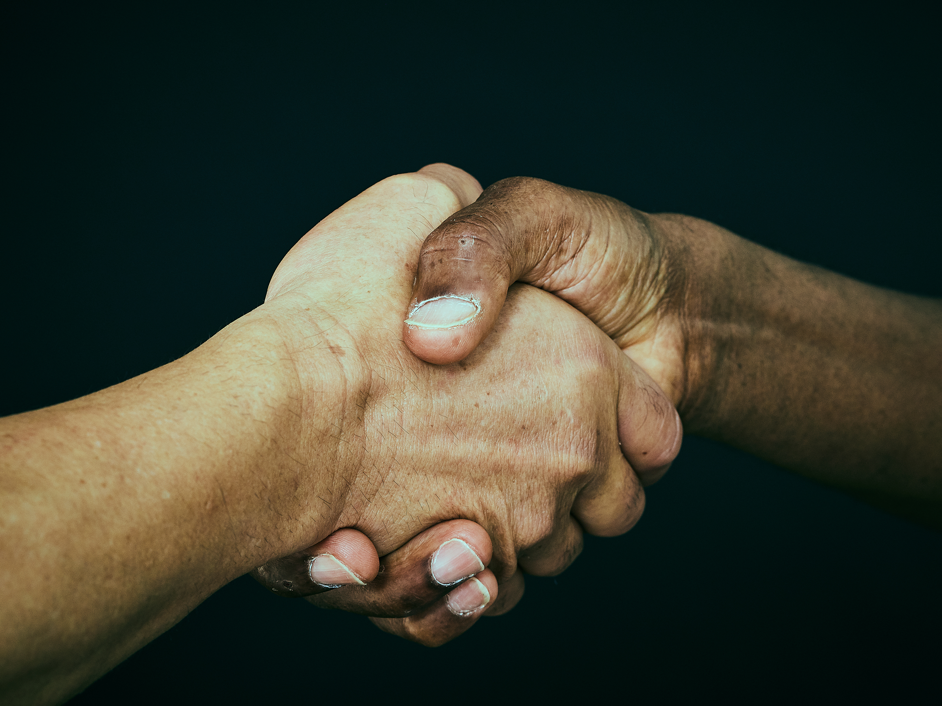
Handshake
I don’t like touching anyone.
I sweat a lot.

Slide 10
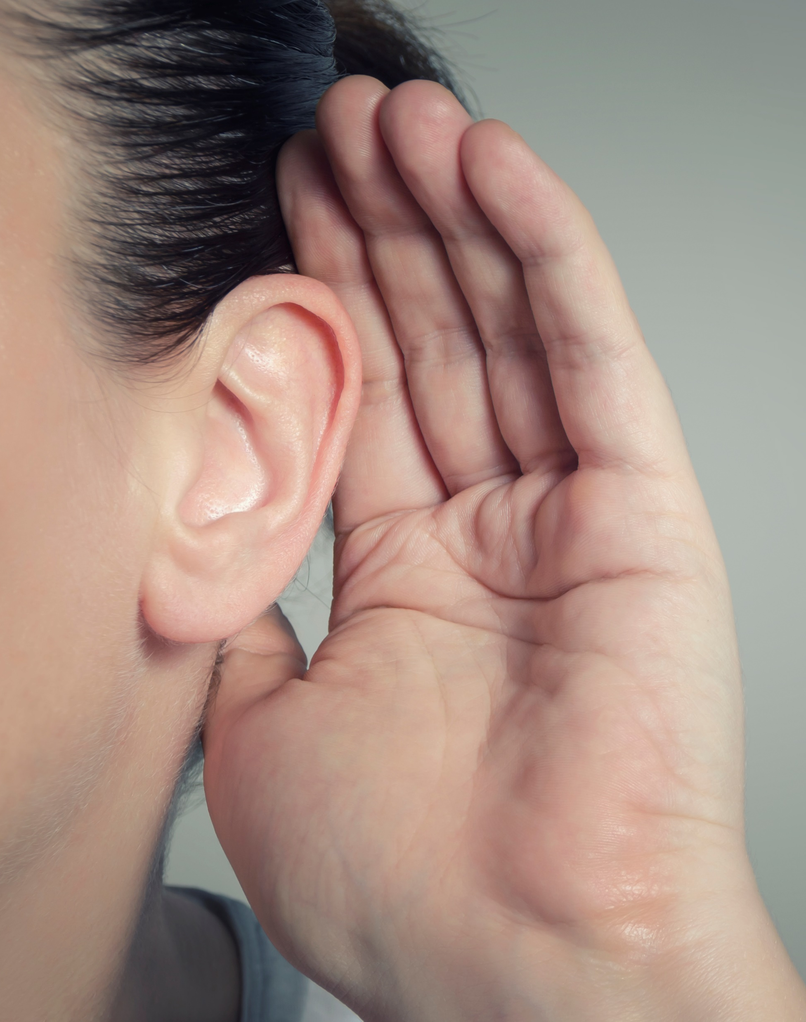
Listen
Look like you’re listening.

Slide 11
Pay attention to the person.
Look
Listen

Slide 12
Repeat what you heard.
Being engaged

Slide 13
Ask a question.
Be engaged
Be interested

Slide 14
No distractions
No headphones
No cell phones

Slide 15
Remember any?

Slide 16
Let’s Review
Eye contact
Personal space
Conversation
Do not fidget
Handshake
Listen
Pay attention
Repeat what was said
Ask a question
No distractions

Slide 17
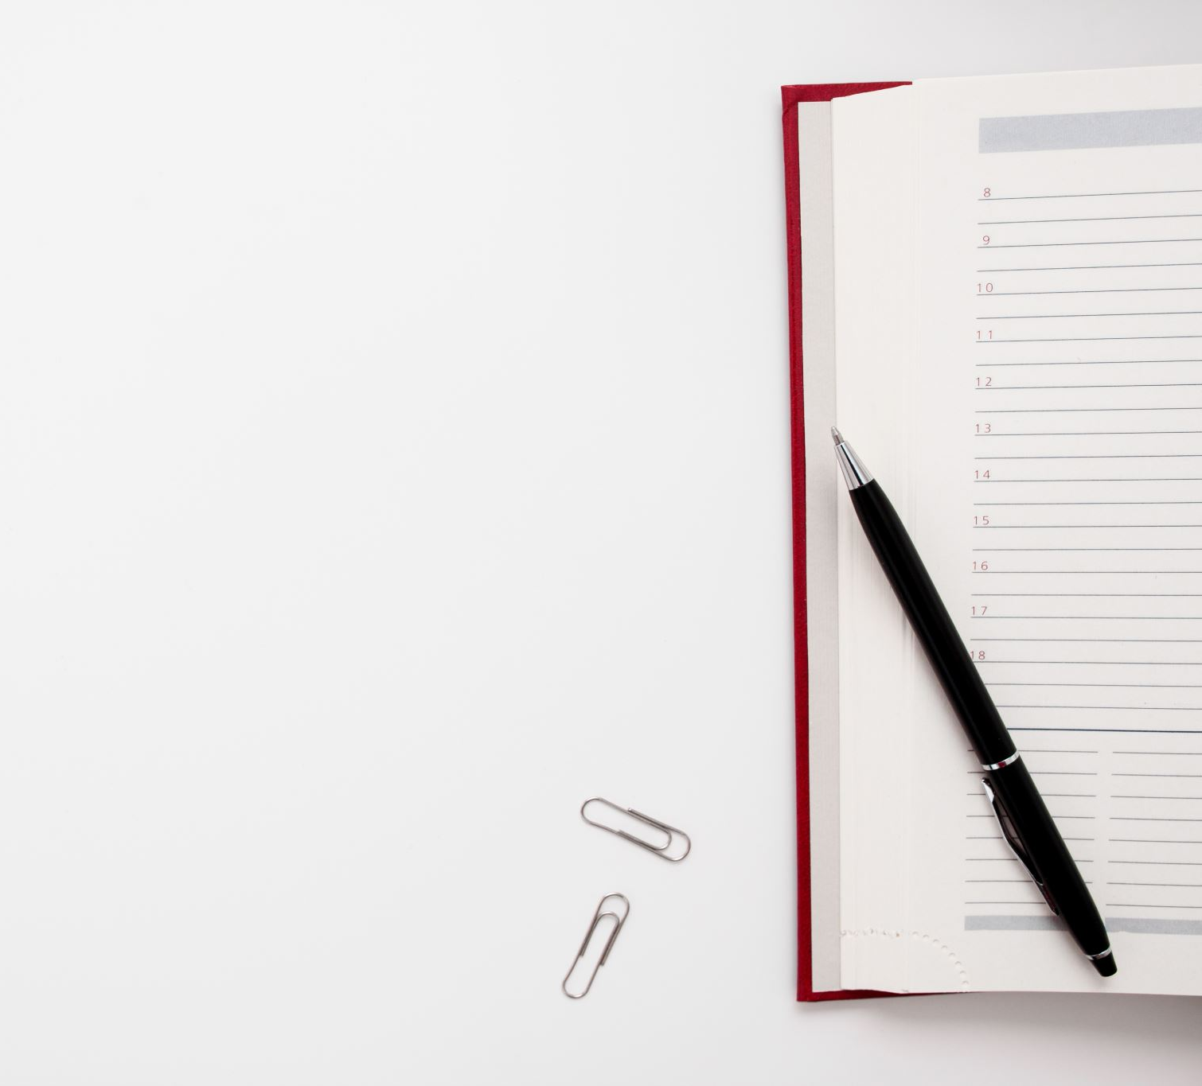
What will be a social goal for you this week?
Write it in your journal.
All photos are free license or taken by E. Doonan.

