Slide 1
Just Breathe

Slide 2
Ways to Reduce Stress
Exercise

Slide 3
How many of you do a form of exercise daily?
Walk
Weights
Dance
Stairs
Bike
Skateboard

Slide 4
We will go over 3 forms of exercise:
Flexibility
Strength
Cardio

Slide 5
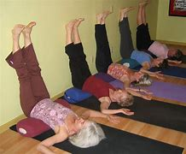
Flexibility
The ability of joints to move through their full range of motion.

Slide 6
Chair Yoga
Chair Yoga

Slide 7
Strength
The ability of muscles to exert force against resistance.

Slide 8
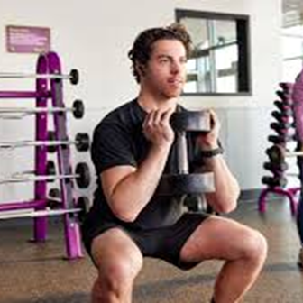
Strength Exercises
https://youtu.be/WIHy-ZnSndA?si=aohiJ6Ede6p17V9u

Slide 9
Cardio
Activities that increase the heart rate.
Improve the efficiency of the heart and lungs.

Slide 10
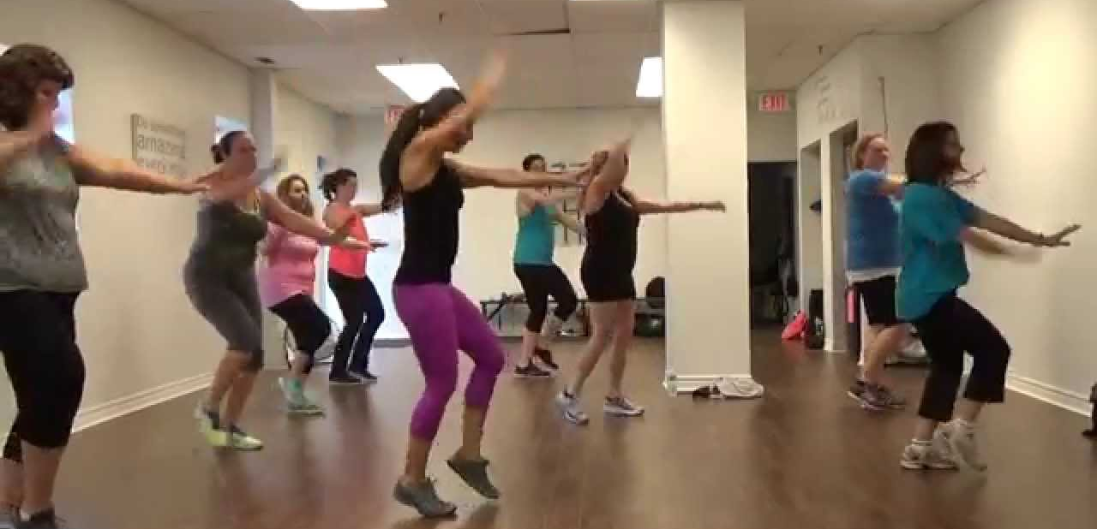
Cardio
Zumba

Slide 11
Summary-What are the benefits of exercise?
Reduces stress
Improves overall well-being

Slide 12
You Got This!
Encourage all to continue incorporate exercise into their daily routines.
Exercise within your abilities.

Slide 13
In the following slides, is it:
Flexibility
Strength
Cardio

Slide 14
Flexibility. Strength. Cardio.

Slide 15
Flexibility. Strength. Cardio.

Slide 16
Flexibility. Strength. Cardio.

Slide 17
Flexibility. Strength. Cardio.

