Slide 1
The Hero’s Journey
Best viewed in Presentation or Slideshow mode. Use the arrow on your keyboard to navigate.
Start
Level 1
Level 2
Level 3
Level 4
Finish
Notes:
https://leaderboardhq.com/gy7lptwk

Slide 2
Warm-up:
What makes a hero?
Start
Level 1
Level 2
Level 3
Level 4
Finish

Slide 3
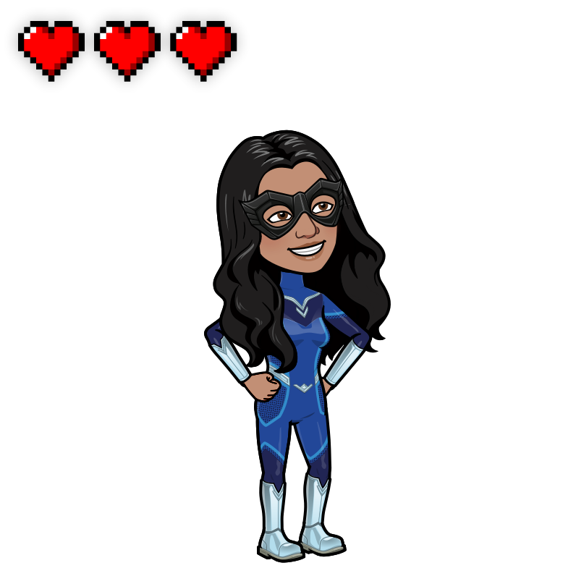
The Hero’s Journey
Start
Level 1
Level 2
Level 3
Level 4
Finish

Slide 4
The Hero’s Journey
Start
Level 1
Level 2
Level 3
Level 4
Finish

Slide 5
Level 1: What is the Hero’s Journey?
From Joseph Campbell, an author
Wrote that heroes have different stages
Start
Level 1
Level 2
Level 3
Level 4
Finish

Slide 6
Level 1: Hero’s Journey vs. Story Plot
Hero’s Journey
Has 12 stages
Cyclical
Story Plot
Has 5 events: exposition, rising action, climax, falling action, resolution
Linear
Start
Level 1
Level 2
Level 3
Level 4
Finish
Notes:
Points: motivation

Slide 7
Level 1: So many stages… watch out!
Abyss
Death of mentor
Battle with brother
Temptation
Road back
Call to action
Refuse the call
Mentor appears
Cross the threshold
Helper appears
Refuse to return
Gift
Master
Start
Level 1
Level 2
Level 3
Level 4
Finish
Notes:
Progression: we like to see progress, no matter how small; it’s nice to celebrate that progress with anything from a sticker, to a star on their assignment, to a passing letter grade
Points: motivation

Slide 8
Start
Level 1
Level 2
Level 3
Level 4
Finish

Slide 9
Start
Level 1
Level 2
Level 3
Level 4
Finish

Slide 10
Level 2: Where can you find the Hero’s Journey?
Various sources!
Books and movies follow the Hero’s Journey
Main character development
Exciting adventure
Start
Level 1
Level 2
Level 3
Level 4
Finish
Notes:
Progression: we like to see progress, no matter how small; it’s nice to celebrate that progress with anything from a sticker, to a star on their assignment, to a passing letter grade
Points: motivation

Slide 11
Level 2: Where can you find the Hero’s Journey?
Various sources!
Books and movies follow the Hero’s Journey
Main character development
Exciting adventure
Start
Level 1
Level 2
Level 3
Level 4
Finish
Notes:
Progression: we like to see progress, no matter how small; it’s nice to celebrate that progress with anything from a sticker, to a star on their assignment, to a passing letter grade
Points: motivation

Slide 12
Level 2: Food for thought…
Name some books or movies that follow the Hero’s Journey
Start
Level 1
Level 2
Level 3
Level 4
Finish
Notes:
FOOD FOR THOUGHT!
Progression: we like to see progress, no matter how small; it’s nice to celebrate that progress with anything from a sticker, to a star on their assignment, to a passing letter grade
Points: motivation

Slide 13
Start
Level 1
Level 2
Level 3
Level 4
Finish

Slide 14
Start
Level 1
Level 2
Level 3
Level 4
Finish

Slide 15
Level 3: “Why Maui Snared the Sun”
How does the story of Maui show the Hero’s Journey? Which parts of the story fit in each stage?
Start
Level 1
Level 2
Level 3
Level 4
Finish
Notes:
Gamify unit work
Points: motivation

Slide 16
Start
Level 1
Level 2
Level 3
Level 4
Finish

Slide 17
Level 4: Share-Out
How does the story of Maui show the Hero’s Journey? Which parts of the story fit in each stage?
Start
Level 1
Level 2
Level 3
Level 4
Finish
Notes:
Progression: we like to see progress, no matter how small; it’s nice to celebrate that progress with anything from a sticker, to a star on their assignment, to a passing letter grade
Points: motivation

Slide 18
You’ve completed the Hero’s Journey!
Start
Level 1
Level 2
Level 3
Level 4
Finish

Slide 19
More reading
https://creativeeducator.tech4learning.com/2013/lessons/Heros-Journey
Start
Level 1
Level 2
Level 3
Level 4
Finish

Slide 20
Credits
Sounds from: https://pixabay.com/sound-effects/search/game/
Background: Canva
Avatar: Bitmoji
Start
Level 1
Level 2
Level 3
Level 4
Finish

