Slide 1
It’s All About Communication

Slide 2
Communication is being part of a team.

Slide 3
Does anyone know how?

Slide 4
Here are some reasons:
Builds healthy work relationships
Increases your self-esteem
Create a stable work environment
Good standing with employees and employer
1

Slide 5
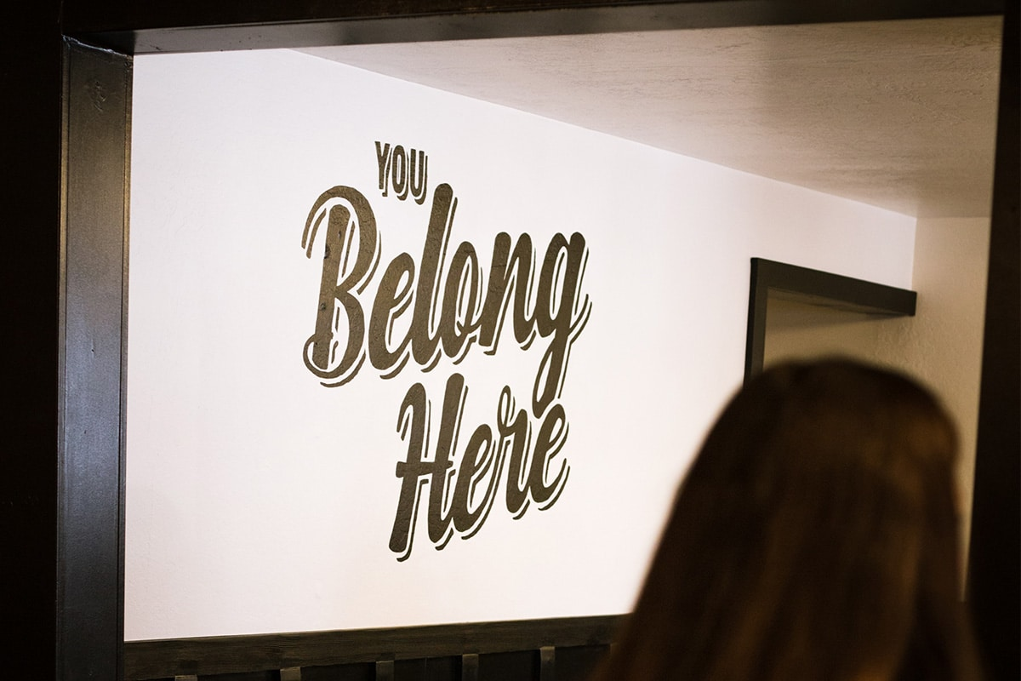
Improves employee cooperation
Team members acknowledge each other
A sense of belonging
You become more satisfied
2
This Photo by Unknown Author is licensed under CC BY-SA

Slide 6
Communication helps with employee wellbeing.
You feel good, your work is better.
Your attitude is positive.
You may want to work more hours=$$$
3
This Photo by Unknown Author is licensed under CC BY

Slide 7
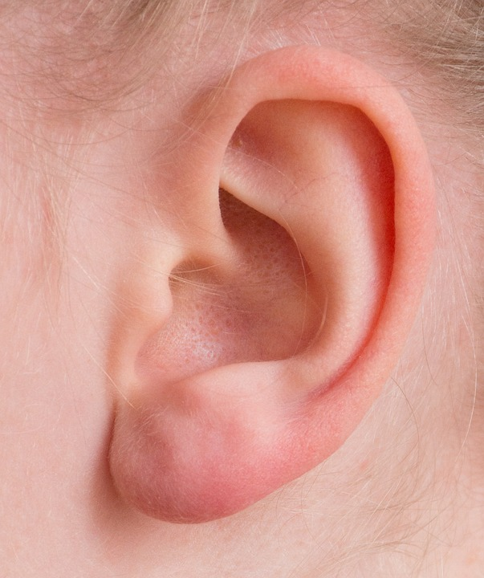
What skill do you use to achieve this?
Active listening

Slide 8
What is active listening?
This Photo by Unknown Author is licensed under CC BY-SA

Slide 9
Active Listening…
Being fully engaged in a conversation.
You may ask questions.
Take turns listening to each other.
This Photo by Unknown Author is licensed under CC BY-NC-ND

Slide 10
Active Listening…
https://youtu.be/3_dAkDsBQyk?si=zfPnsWCNA8hR2YDV

Slide 11
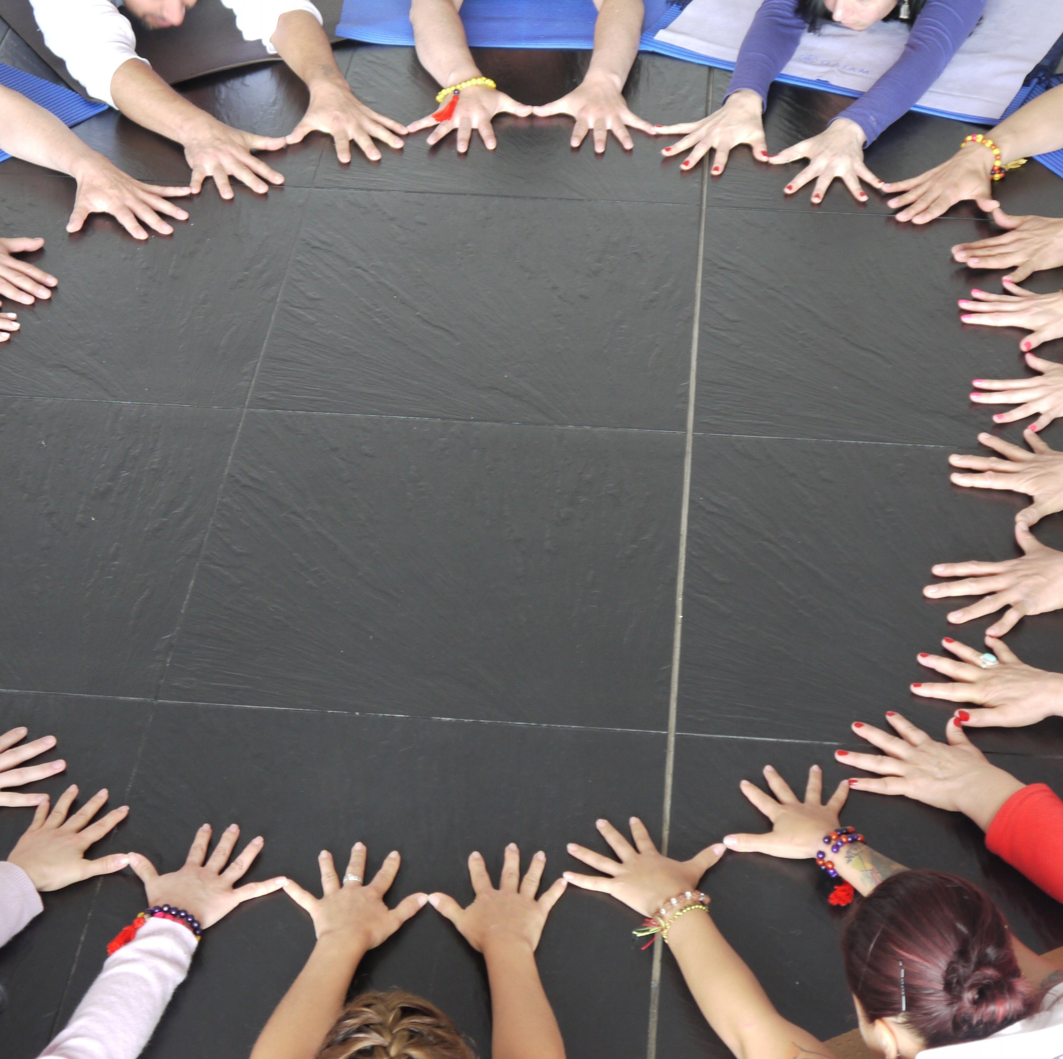
Summary
Is teamwork only for work ?
Where else can you use teamwork?

Slide 12
Information:
Google search
ChatGPT
SDCCD/DSPS Community Living Skills curriculum

