Slide 1
Resume Samples
What is a resume?

Slide 2
Resume
A document used to present your personal background, skills and accomplishments.
Notes:
Advertisement selling a product….YOU!
Specifically your skills, experiences, and attributes.
First meeting between you and the employer
Overall it is the first step to employment
As you begin, maybe start by writing down a list of the biggest milestones in your academic or working career.

Slide 3
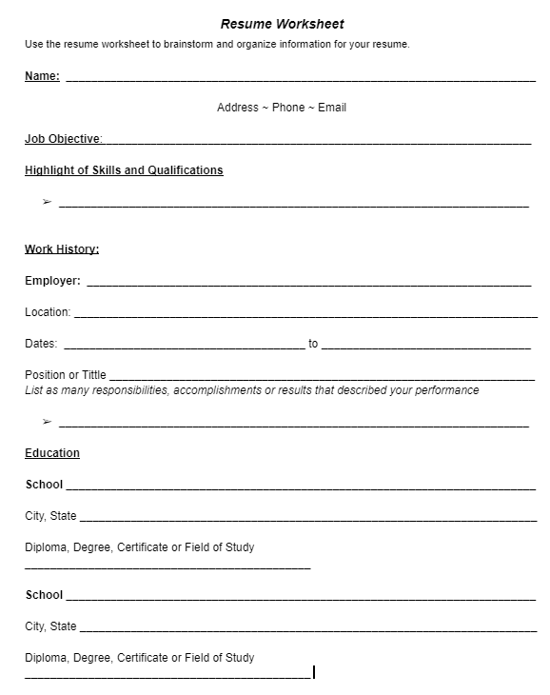
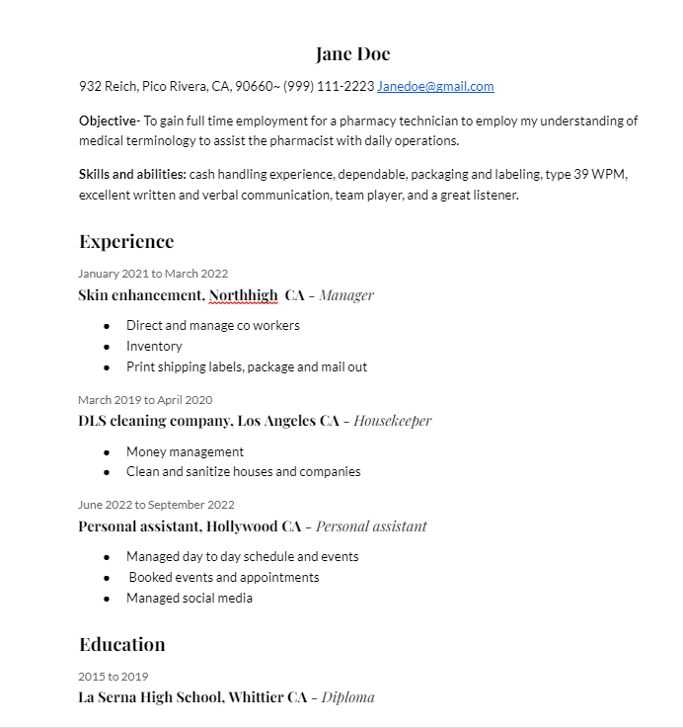
What does it look like?
Notes:
The average employer looks at a resume between 10-15 seconds. This is the time they decided to keep it or toss it.

Slide 4
What should be included on a Resume
Header -Contact Details
Resume introduction- Objective
Education
Experience
Skills
Short concise Sentences
Notes:
The header of your resume should be the Name, present address, email and phone number, it should always be placed at the top.
Objective - Serves as a place to communicate the type of position you are interested in. To obtain a position in the customer service field.
Work Experience: Don't forget non-traditional work, such as babysitting or helping out with the family business. For each item, include the job title, name of organization, location, dates, and description of responsibilities.

Slide 5
Include Soft Skills
Problem Solving
Critical Thinking
Flexibility
Communication Skills
Teamwork
Organizational Skills

Slide 6
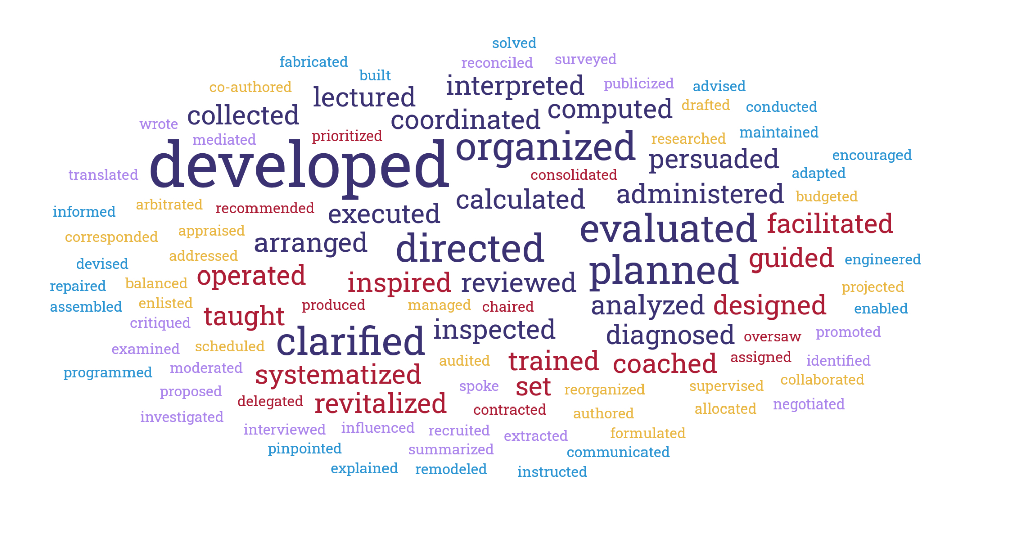
Include Action Words

Slide 7
What not to include
Personal information
The first person “I”, “me”, “my”, etc.
List of references
Non essential information
Notes:
Personal information such as age, marital status or number of children, or a personal picture
The first person “I”, “me”, “my”, etc.
List of references or “References Available Upon Request”
Do not clutter your resume with nonessential information

Slide 8
Resume Test
Neat
Well-Organized
Error Free
Professional Appearance
Notes:
What does your resume say about you?
Are you neat?
Well organized?
Attention to detail
Careful and Compent

Slide 9
Get Feedback
Notes:
•Have at least one other person look it over

