Slide 1
Cover Letters

Slide 2
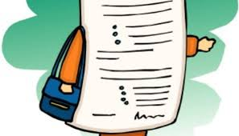
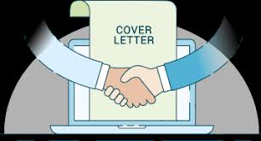
Objective
Explain the parts of a cover letter, the purpose and how to format and proofread

Slide 3
What is a cover letter?
Introduces you to the employer
One one page long
Prepares reader for your resume

Slide 4
Prepares reader for your resume
Why are your writing
Why you are a good match for the job
Sample of your writing abilities

Slide 5
Parts of a cover letter
Heading
Introduction
Body
Closing

Slide 6
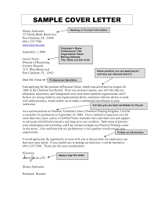
Heading
Contains your contact information
Date of your letter
Name of the person the letter is addressed to
Verify the person’s title

Slide 7
Introduction
Greeting
Specify the position you are applying for
Tell how you learned about job
State why you are the best candidate for the job
Notes:
In some cases, you may have been referred to a potential employer by a friend or acquaintance. Be sure to mention
this mutual contact, by name, up front since it is likely to encourage your reader to keep reading!
If you are writing in response to a job posting, indicate where you learned of the position and the title of the position.
More importantly, express your enthusiasm and the likely match between your credentials and the position's
qualifications.
If you are writing a prospecting letter a letter in which you inquire about possible job openings - state your specific job
objective. Since this type of letter is unsolicited, it is even more important to capture the reader’s attention.
If you are writing a networking letter to approach an individual for information, make your request clear.

Slide 8
Body
Use one paragraph for each one of the qualifications you want to highlight
Give specific examples
Make references to your resume DO NOT repeat it
Notes:
In responding to an advertisement, refer specifically to the qualifications listed and illustrate how your particular
abilities and experiences relate to the position for which you are applying. In a prospecting letter express your
potential to fulfill the employer's needs rather than focus on what the employer can offer you. You can do this by
giving evidence that you have researched the organization thoroughly and that you possess skills used within that
organization.
Emphasize your achievements and problem-solving skills. Show how your education and work skills are transferable,
and thus relevant, to the position for which you are applying.

Slide 9
Closing
Remind the prospective employer you are the right candidate for the job and why
Ask for an interview
Thank the person for taking the time to read your information
Tell them you will follow up with a phone call
Notes:
Close by reiterating your interest in the job and letting the employer know how they can reach you and include your
phone number and/or email address. Or bid directly for the job interview or informational interview and indicate that
you will follow-up with a telephone call to set up an appointment at a mutually convenient time. Be sure to make the
call within the time frame indicated.
In some instances, an employer may explicitly prohibit phone calls or you may be responding to a “blind want-ad”
which precludes you from this follow-up. Unless this is the case, make your best effort to reach the organization. At
the very least, you should confirm that your materials were received and that your application is complete.
If you are applying from outside the employer’s geographic area you may want to indicate if you’ll be in town during a
certain time frame (this makes it easier for the employer to agree to meet with you).
In conclusion, you may indicate that your references are available on request. Also, if you have a portfolio or writing
samples to support your qualifications, state their availability.

Slide 10
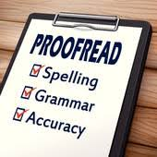
Before you send
Proofread

Slide 11
Proofread
Wait a few hours after writing the letter
Read letter
Give to another person to help you with proofreading

Slide 12
Cover letters will change depending on the job!

