Slide 1
Inventions that Changed the World: Present and Past Passive
Created by Kristi Reyes
OTAN

Slide 2
Do you know?
Who discovered penicillin, the first known antibiotic?
When were X-rays discovered?
How long ago the screw was created?
Who invented the telephone?
What did the first television look like?
When was the first computer invented?

Slide 3
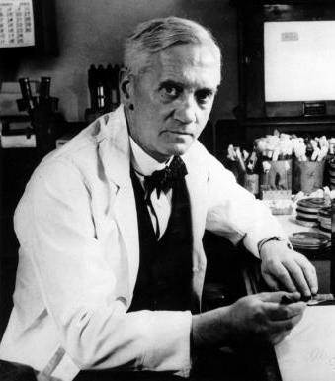
Penicillin – Alexander Fleming
This file is made available under the Creative Commons CC0 1.0 Universal Public Domain Dedication

Slide 4
X-rays – Wilhelm Roentgen
This work is in the public domain in its country of origin and other countries and areas where the copyright term is the author's life plus 70 years or fewer.

Slide 5
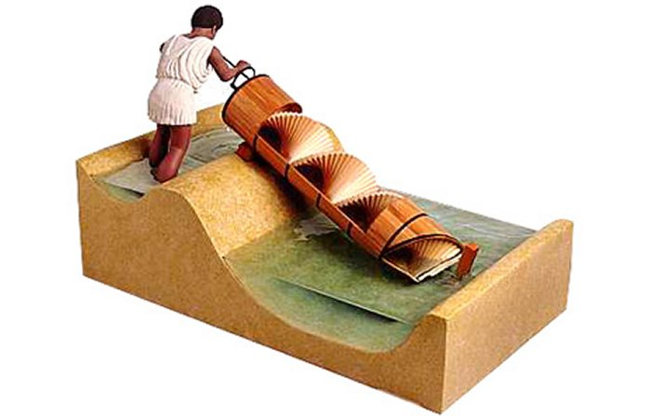
The screw - Archimedes
This file is made available under the Creative Commons CC0 1.0 Universal Public Domain Dedication

Slide 6
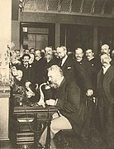
Telephone – Alexander Graham Bell
This work is in the public domain in its country of origin and other countries and areas where the copyright term is the author's life plus 70 years or fewer

Slide 7
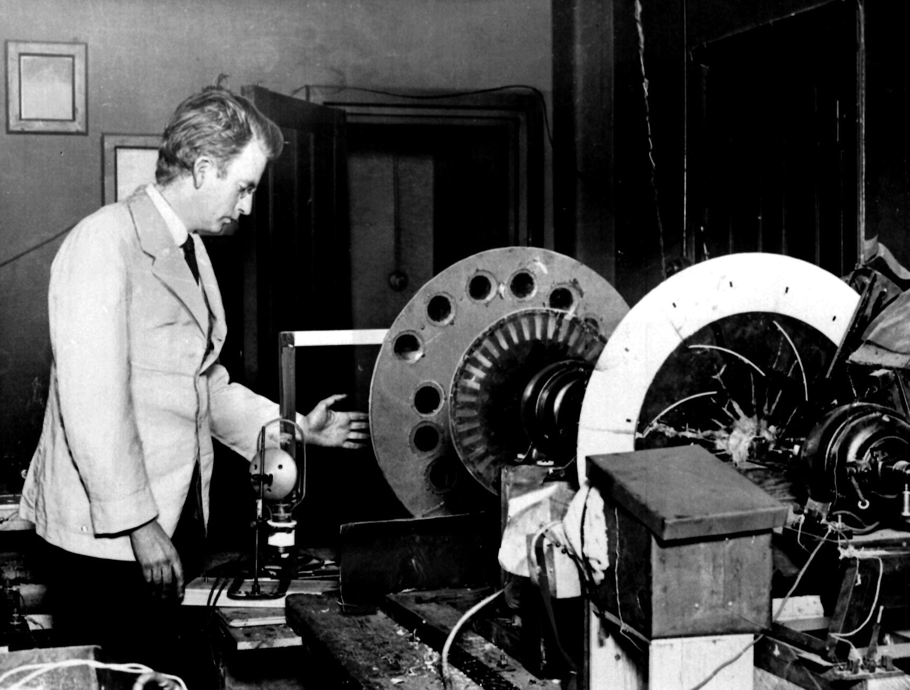
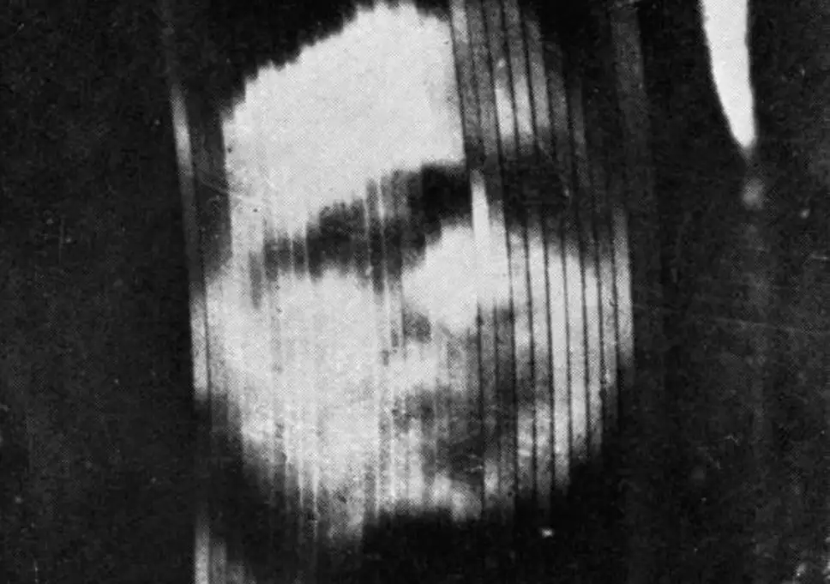
First TV – John Logie Baird
First TV Image
This work is in the public domain because it was published in the United States between 1927 and 1963, and although there may or may not have been a copyright notice, the copyright was not renewed.

Slide 8
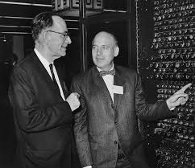
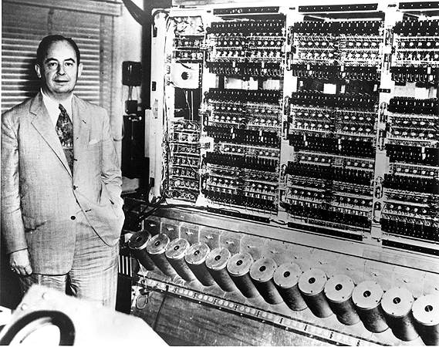
First Computer – J. Presper Eckert, Jr. and John W. Mauchly

Slide 9
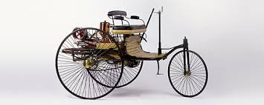
English
Is an S – V – O language
This means that the word order is normally
Subject + Verb + Object
As in the following sentence:
Karl Benz created the first automobile.
This file is made available under the Creative Commons CC0 1.0 Universal Public Domain Dedication
Subject
Verb
Object

Slide 10
Usually …The subject does the action (verb)
But …Sometimes …
The subject does not really do the action of the verb.
For example:
The first car was created in Germany.
The agent (person or thing that does the action) is unknown or unstated. We can say that the agent is Karl Benz. In that case, we can add …
Subject
Verb
by Karl Benz.

Slide 11
Present Passive
Subject becomes the object and the object becomes the subject
Lowell Wood patents many inventions annually. (Active)
Many inventions are patented by Lowell Wood annually. (Passive)
Verb changes to “is/are” + past participle

Slide 12
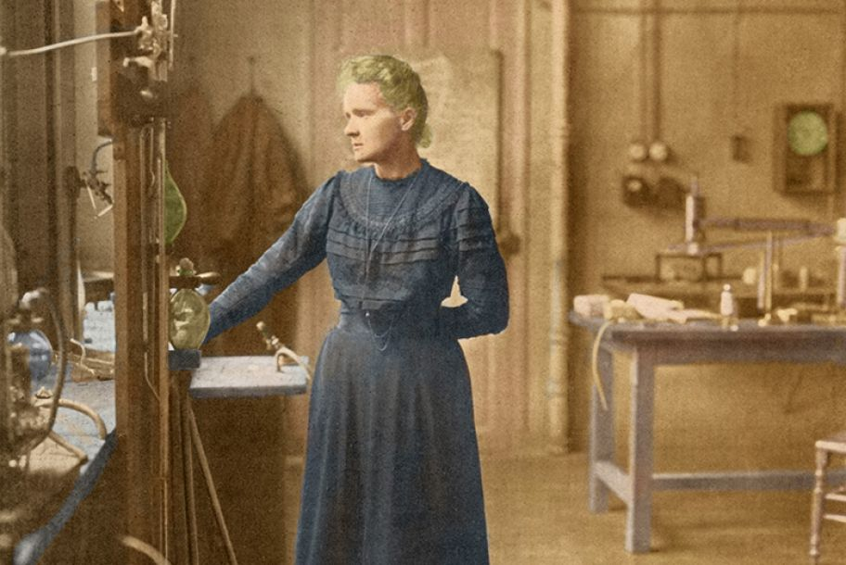
Past Passive
Subject becomes the object and the object becomes the subject
Marie Curie formed the theory of radioactivity. (Active)
The theory of radioactivity was formed by Marie Curie. (Passive)
Verb changes to
“was/were”
+ past participle

Slide 13
What is a past participle?
For regular verbs
The verbs that take –ed to form past tense
The past participle is the same
Liked, discovered, formed, etc.
For irregular verbs
The past participles need to be memorized
See (seen), know (known), give (given), etc.

Slide 14
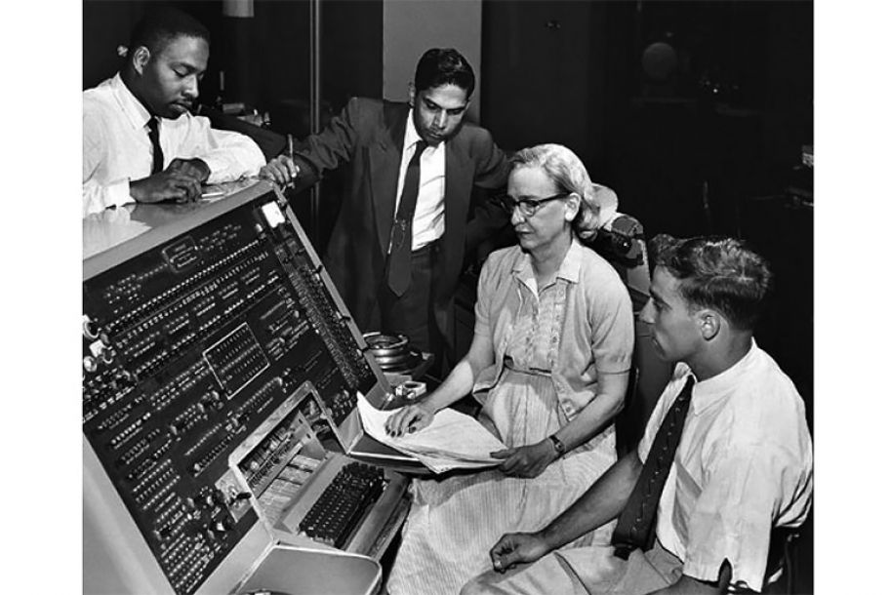
What’s the difference?
Grace Hopper designed Harvard’s Mark I computer, a five-ton, room-size machine, in 1944. (Active)
A tool to translate written language into computer code was invented around the same time. (Passive)

Slide 15
Your Job:
What are the top three most important inventions / discoveries / creations, in your opinion?
Who were they invented by?
When were they invented?
Where were they invented?
Why were they invented? What are/were they used to do?
Complete the table on your paper.

Slide 16
Active: We speak English.
Passive: English is spoken here.
Images from Wikimedia and Pixabay

